Slide 1





Oracle Cloud Solution Hubs Embracing Data Variety with
Oracle Cloud
Steven Black
Mark Geurtsen
March 2018

Slide 2


Difficult to get specialized skilled people with Big Data and Machine Learning knowledge
Requires heavy computing resources
Avocados Inc. wants to get better insights on their marketing campaigns.
To do this they require Big Data and Machine Learning. These areas require technical resources and computing power.
Copyright © 2017 Oracle and/or its affiliates. All rights reserved. |

Slide 3

With Oracle Analytics and Oracle Analytics Cloud it’s easy to create an integrated solution. This allows Avocado Inc. to blend multiple datasources coming from Big Data, static files and other Oracle SaaS or third party applications. It also gives a platform for realtime analytics provided with Machine Learning capabilities.
Copyright © 2017 Oracle and/or its affiliates. All rights reserved. |

Slide 4
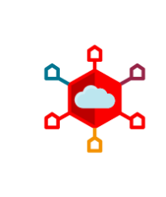






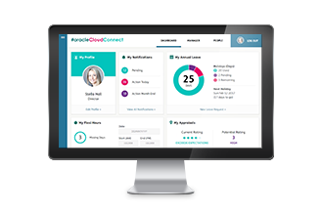




Notional Architecture
Embracing Data Variety with Oracle Cloud
Twitter as a publisher in Kafka
Revenue from Oracle Fusion ERP Finance Cloud (demo content)
Roland
CIO
Event Hub Cloud
Lisa
Marketing Executive
Big Data as a Consumer of Kafka
Interaction
Default connection between Analytics and Big Data
Oracle Analytics
Cloud Service
Oracle Big Data Cloud
Marketing budgets stored in Excel, blended in Analytics
Analytics datasets stored in Database Cloud
Database
Cloud Service
Copyright © 2018, Oracle and/or its affiliates. All Rights Reserved. | Confidential – Oracle Internal
Notes:
.

Slide 5







Business Value
Embracing Data Variety with Oracle Cloud
Key Value
Machine Learning
An integrated platform to work with Big Data, Machine Learning and realtime Analytics using the latest technologies
Abilities to blend multiple datasources: Big Data, static datafiles, Oracle applications and third party SaaS
Moves an organization from “Keeping the lights on” to innovation
Provides easy up-/downscaling depending on the need
Big Data
Analytics
Integrated
Risk Impact
Cost Impacts
Data blending
Reduce Time to act by providing Analytics in Realtime
Lower operation cost
Reduces up-front cost
Scaleable
Copyright © 2018, Oracle and/or its affiliates. All Rights Reserved. | Confidential – Oracle Internal
Notes:
.

Slide 6

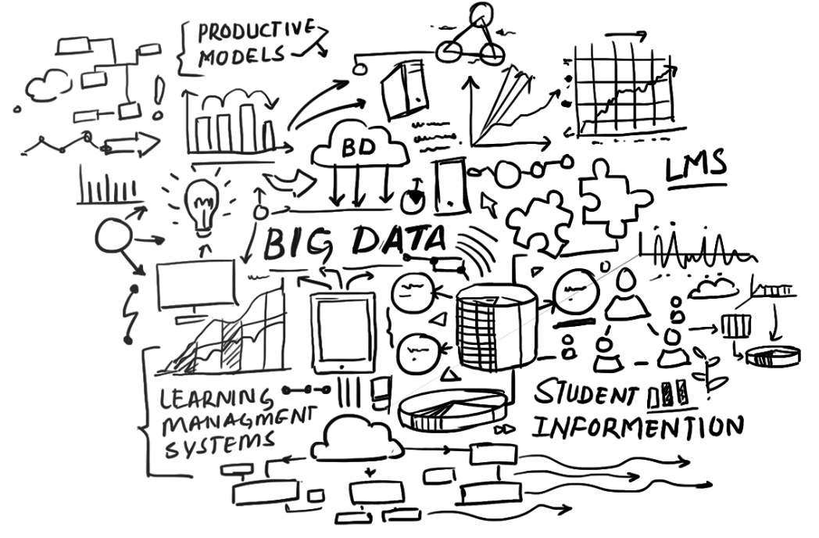









Solution Highlight
Embracing Data Variety with Oracle Cloud
Go to the Solution Bank Asset Page
Go to the Asset Folder in ODocs
Watch the Solution Prototype Video
Avocado's Incorporated is a lifestyle branding company that sells avocados and other avocado based products.
Using Oracle Analytics Cloud and Oracle's Big Data Platform we manage to do datablending from different datasources and apply built-in Machine Learning capabilities to realtime Analytics.
This gives Avocado's Incorporated a better insight into their business, tracking marketing campaigns and keep innovating using the latest technology.
Lead ECA Name
Lead Developer Name
Cloud Developer Name
Cloud Developer Name
Copyright © 2018, Oracle and/or its affiliates. All Rights Reserved. | Confidential – Oracle Internal
Notes:
.

